Slide 1
EBS Volume
It is a durable, block-level storage device that you can attach to a single EC2 instance.
You can use EBS volumes as primary storage.
you can dynamically increase size, modify the provisioned IOPS capacity, and change volume type on live production volumes.
volume types:
General Purpose SSD (gp2)
Provisioned IOPS SSD (io1)
Throughput Optimized HDD (st1)
Cold HDD (sc1)
Magnetic (standard, a previous-generation type)

Slide 2
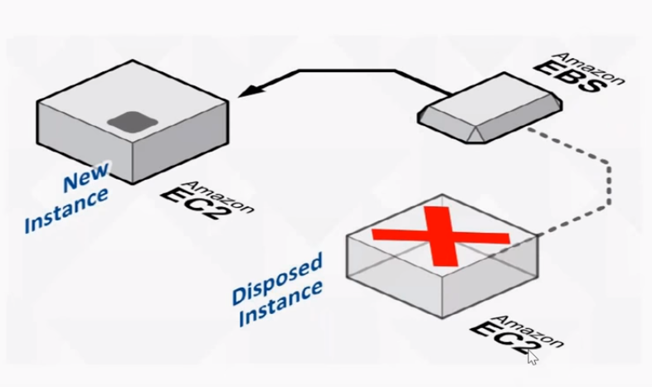
Availability Zone specific.
Persistent block level storage volumes offer consistent and low-latency performance.
Data is persistent independent of the EC2 instance.
Stored data is automatically replicated within it's A.Z.

